Slide 1
Conservation, Farmer Perspectives and the Policy Landscape

Slide 2


Thank you to our funders and partners

Slide 3
The Changing Policy Landscape?
Where does conservation on ag lands fit into the policy landscape?
A Shift to Nature?
  Platform – “Protect Nature” (but where was agriculture?)
  Secretary of State for Nature
Diverse approaches in ag conservation
  Opportunities for coherence, collaboration and cooperation?
Agriculture Policy Framework is up for renegotiation
  Last framework added the Resilient Agricultural Landscape Program
  “Conservation” largely absent

Slide 4
The Changing Landscape
Canada is farming fewer acres

Slide 5
Producer Survey
Aiming to better understand the producer perspective
Land use and conservation are sensitive issues on farms across Canada
The environment vs economy tension seems heightened on land use issues.
  Despite interconnectedness, farmers may see fewer direct benefits and more potential threats to their way of farming.
Three questions guided the survey design:
  What are farmer priorities on environmental issues?
  What awareness is there of conservation programs and what would farmers like them to do?
  What would farmers perceive as a higher-impact approach for ag conservation?
With 453 responses (demographics in the Annex) it provides some insights into farmer priorities and perspectives.

Slide 6
Attitudes on Land Use Change

Slide 7
Land Use Decision Making
Other Economic Considerations
Soil Improvement
  Enhancing the quality and fertility of the soil to support better crop growth and sustainability.
Crop Rotation
  Importance of rotating crops to maintain soil health, reduce pests and diseases, and improve crop yields.
Livestock Feed
  The need for adequate feed for livestock, which is crucial for maintaining healthy and productive animals.
Water Management
  The importance of managing water resources effectively, including improving drought tolerance and ensuring proper drainage.
Time Management
  Efficient use of time in agricultural practices to maximize productivity and reduce labour costs.

Slide 8
Land Conversion
Other Considerations
Economic Factors:
Profit: Farmers are motivated by the potential for higher profits
Land Prices: High land prices encourage farmers to maximize the use of their land
More Acres: The need for more cultivated acres to increase production
Field Efficiency: Improving field efficiency and making farming easier with larger equipment
Repayment Periods: The price of land and repayment periods influence decisions
Proximity to Cities: Losing rented land to developers pushes farmers to clear and convert other lands
Livestock Feed Needs: The need for livestock feed influences land conversion
Environmental Factors:
Invasive Species: Mitigating the spread of invasive species into forage and grazing lands
Wildlife Management: Managing wildlife populations that affect farming
Soil Quality: Improving soil quality and better land use in dry areas

Slide 9
Environmental Priorities

Slide 10
Barriers to action
Trust and Buy-in issues
Programs often feel like top-down rules, not tools farmers helped create, leading to trust issues and low participation.
Survey insights
Among participants, 68% find applications manageable but time-consuming, and 19% find them overly complex. Top barriers include complex processes (56.3%), insufficient payments (53%), and inflexible requirements (47.2%).
Farmers prefer programs led by conservation groups over government-led ones, with stronger support in the East, suggesting a trust gap with government initiatives.

Slide 11
Current Programming
Misaligned program design
Farmers want programs that fit their operations, but the existing programs are sometimes not farmer-friendly, particularly for smaller farms with limited resources.
Survey insights
Only 6.6% of farmers are “very familiar” with federal and provincial conservation programs, while 44.8% are “somewhat familiar,” 38% are “not very familiar,” and 10.6% are “not at all familiar”.
Preference for payments for specific practices (e.g., buffer strips) over reverse auctions.
Moderate interest in simpler, farm-specific options and outcome-based rewards like reduced soil erosion.
Awareness of specific programs, like the Resilient Agriculture Lands Program, is even lower, with 3.1% very familiar and 49.7% not familiar at all.
Inflexible requirements deter participation, and producers are unsure about long-term benefits.

Slide 12
Barriers to action
Other Considerations
Lack of Knowledge/Information
  Many respondents indicated a lack of knowledge or information about the programs.
Government Intervention/Regulation
  Some respondents expressed concerns about government intervention and regulation.
Effectiveness and Reliability
  Concerns were raised about the effectiveness and reliability of the programs.
Paperwork and Bureaucracy
  The amount of paperwork and bureaucracy involved was a concern for some respondents.
Personal Focus/Commitment
  Some respondents mentioned their personal focus on specific areas or the long-term commitment required.
.

Slide 13
Encouraging participation

Slide 14
Survey takeaways
Low engagement
Only 6.6% very familiar, 33.5% participate. East: 40% participation vs. West: 30%; older, larger, higher-income farms more engaged.
Application process
68% find applications time-consuming; 19% overly complex. Younger farmers report more negative experiences.
Economic priorities
Input costs (73.3%) and commodity prices (59.4%) dominate. West emphasizes land values; younger farmers focus on equipment/innovation.
Shared opportunity
Soil health (62.9%) is a win-win priority, followed by extreme weather (21%), water quality (7%) as top concerns. East emphasizes water quality; younger farmers focus on climate resilience.
Barriers
Complex applications (56.3%), insufficient payments (53%), inflexible requirements (47%).
Land use concerns
Urban expansion, natural land conversion, wetland removal top concerns. East worries about urban sprawl; West focuses on wetlands.
Attitudes and preferences
Preference for practice-based incentives, conservation group-led programs. Technology integration boosts appeal; older, higher-income farmers support easements.

Slide 15
The Perception Problem
The underlying challenge
Farmers are more concerned about urban expansion, less concerned about conversion to agriculture.
Economic pressures push farmers to convert land, clashing with conservation goals, and these pressures differ by region.
Regional differences require new approaches to national solutions.
Different farm types and sizes need tailored solutions: larger farms may handle complex programs, but smaller ones need simplicity.
Is equity (the need to offer farmers and regions similar support) a barrier to a higher impact approach?

Slide 16
Thinking about the future?
A higher impact approach?
Conservation Priorities: Could/should efforts be targeted to the areas with the greatest need, impact or cost benefit?
Managing Volatility: New programs need to stay flexible to keep up with changing economic and environmental conditions.
Increasing Uncertainty: Uncertainty about geopolitical changes and future policies concerns farmers, highlighting the challenge of talking about conservation programs.
  Reluctance to take marginal land out of production is an example
Leveraging technology: Technology, such as precision agriculture, is valued. Technological support is important, and there is a need for practical assistance to adopt conservation practices.
Can conservation policies and programs be better aligned with economic goals, technology adoption, other environmental incentives and partnerships into a higher-impact approach?

Slide 17
Morning Dialogue Questions
Initial rapid-fire question:
What is your perspective on the policy landscape or survey results?
Breakout group questions:
How do you characterize the impact of conservation programming in Canada?
What’s working—and not working—with current conservation policies and programs?
What opportunities do you see for change?

Slide 18
Advancing Policy Solutions Together

Slide 19
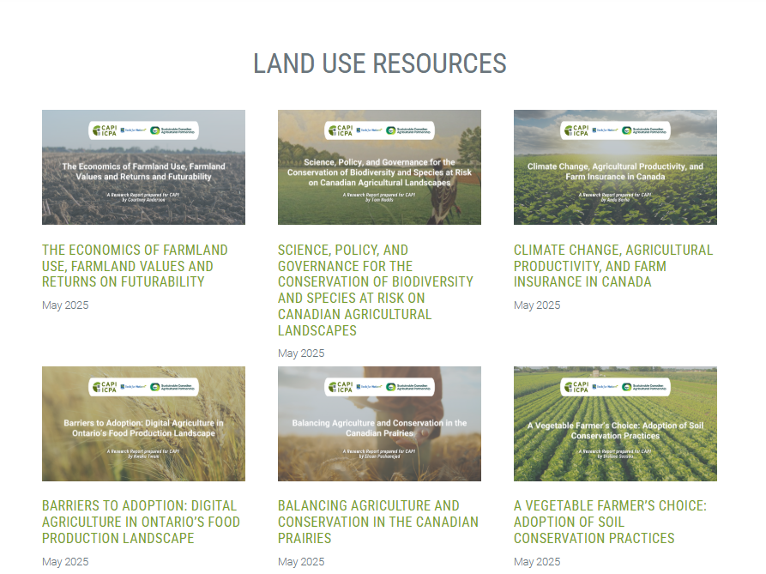
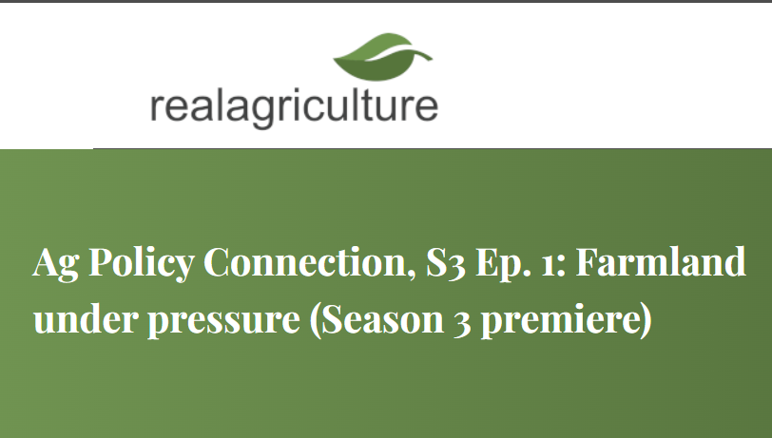
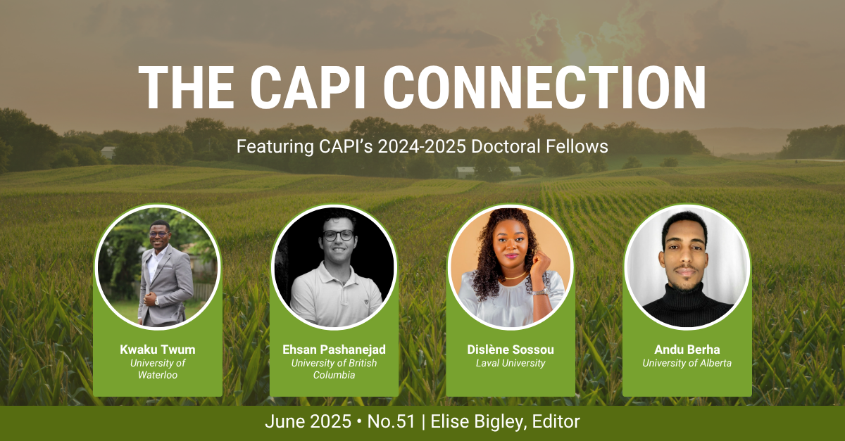
Annex: CAPI’s PLAN Initiative
Policies for Land Use Agriculture and Nature
Purpose: To advance policy solutions that protect, promote and preserve agricultural lands for greater economic, environmental and social sustainability.
Activities:
  Policy Network
  Distinguished Fellows
  Doctoral Fellows
  Podcasts & Webinars
  In-person workshop
  Producer Survey

Slide 20
Annex: Respondents' demographics

Slide 21
Annex: Respondents' demographics

