Slide 1
Agriculture and Food Security: Global challenges and local solutions
Lee Ann Jackson, OECD
12 July 2022

Slide 2
In the last two years, global agricultural commodity prices have increased strongly

Slide 3

Food systems are facing a daunting triple challenge
Food security & nutrition
Livelihoods
Environmental sustainability
Things are not black or white: food systems have important achievements as well as serious shortcomings
Better policies can make a difference: existing OECD work has identified many areas for improvement

Slide 4
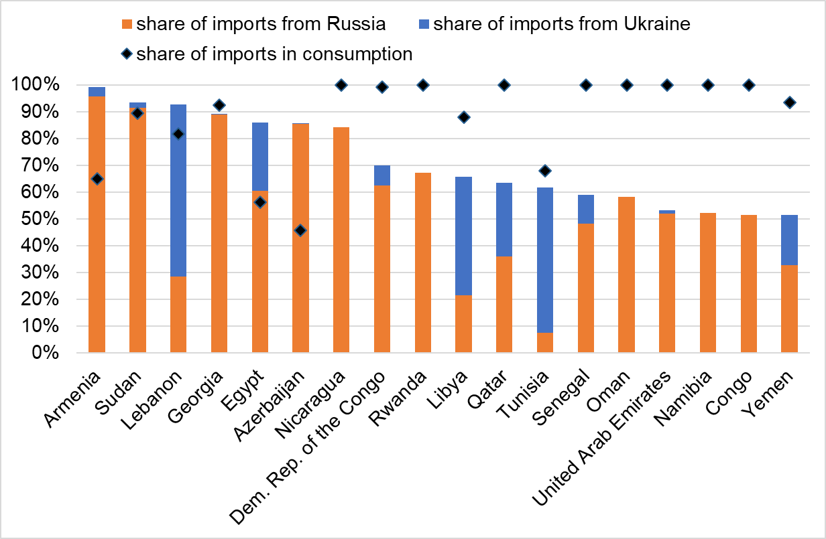
Current disruptions add to these challenges
Source: UN Comtrade average for 2018-2020
Notes:
Import dependency on Ukraine and Russia for wheat

Slide 5
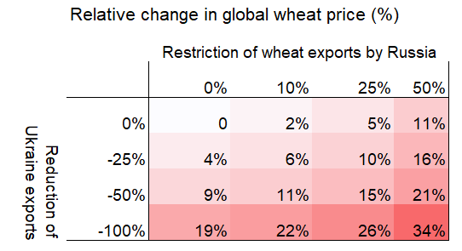
Global food security impacts of trade disruptions
(Scenario results)
0% -10% -25% -50%
Based on preliminary scenarios with Aglink-Cosimo
Notes:
Full loss of UKR export capacity leads to 19% increase in global wheat price
If Russia were to cut exports by 50%, wheat prices would be 34% higher than without the war.
Two countries would decrease exports, but other countries would increase their exports due to higher international prices

Slide 6

OECD-FAO Agricultural Outlook
Joint OECD-FAO report published annually in June/July
10 year horizon
Projections based on modelling and global expert input
Global coverage
Detailed chapters for all major commodities
Released : 29 June 2022
www.agri-outlook.org

Slide 7
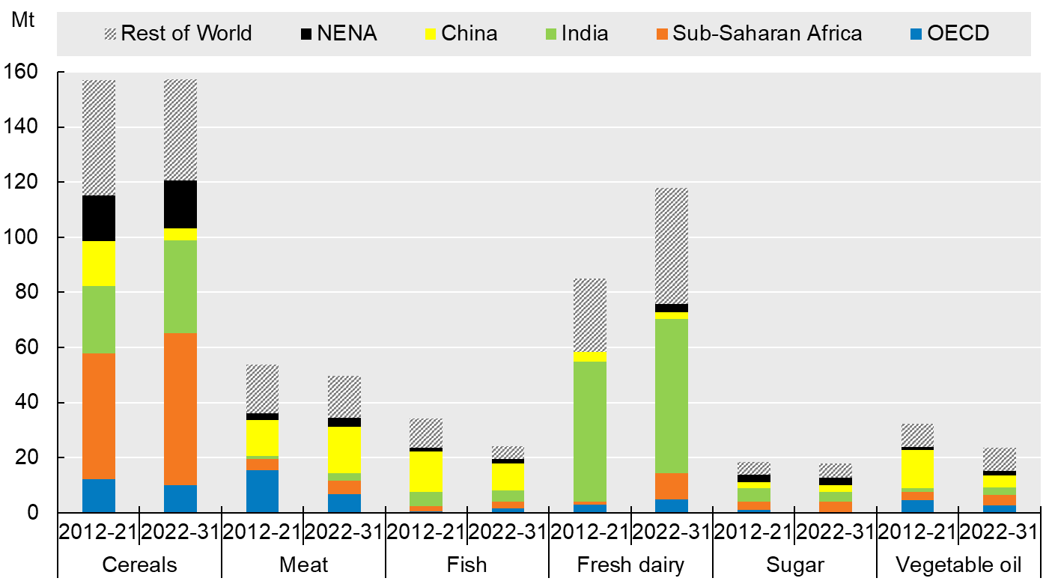
Low and middle-income countries drive food demand growth

Slide 8
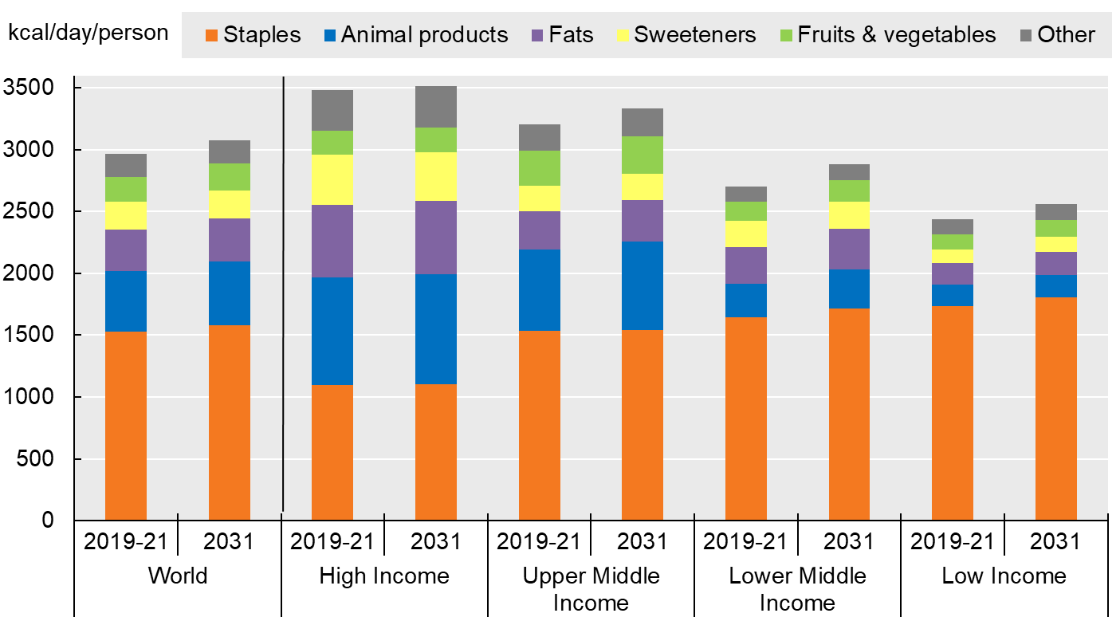
Limited convergence in diet composition
Per capita availability of the main food groups (in calories)
Notes:
Note: Estimates are based on historical time series from the FAOSTAT Food Balance Sheets database which are extended with the Outlook database. Products not covered in the Outlook are extended by trends. The 38 individual countries and 11 regional aggregates in the baseline are classified into the four income groups according to their respective per-capita income in 2018. The applied thresholds are: low: < USD 1 550, lower-middle: < USD 3 895, upper-middle: < USD 13 000, high: > USD 13 000. Staples include cereals, roots and tubers and pulses. Animal products include meat, dairy products (excluding butter), eggs and fish. Fats include butter and vegetable oil. Sweeteners include sugar and HFCS. The category others includes other crop and animal products.

Slide 9
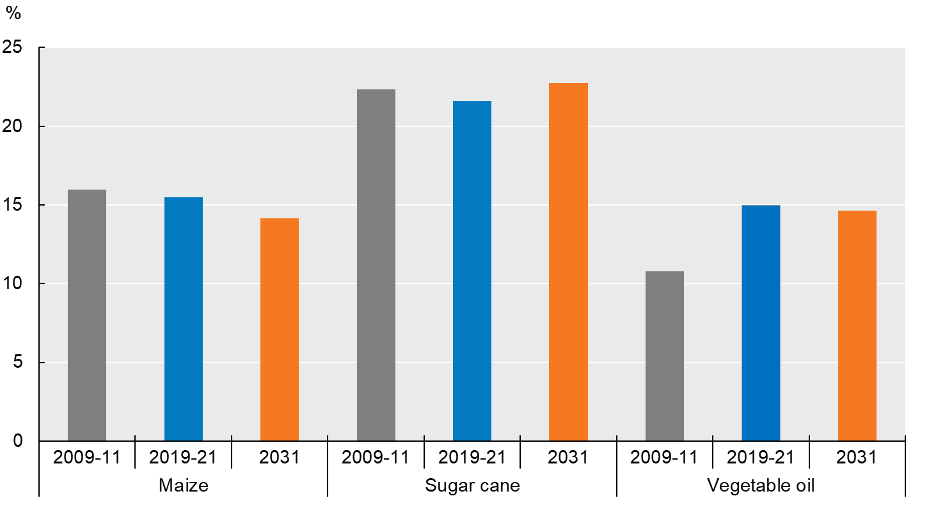
Biofuel share of agricultural commodities is stabilizing
Biofuel as a share of total use

Slide 10
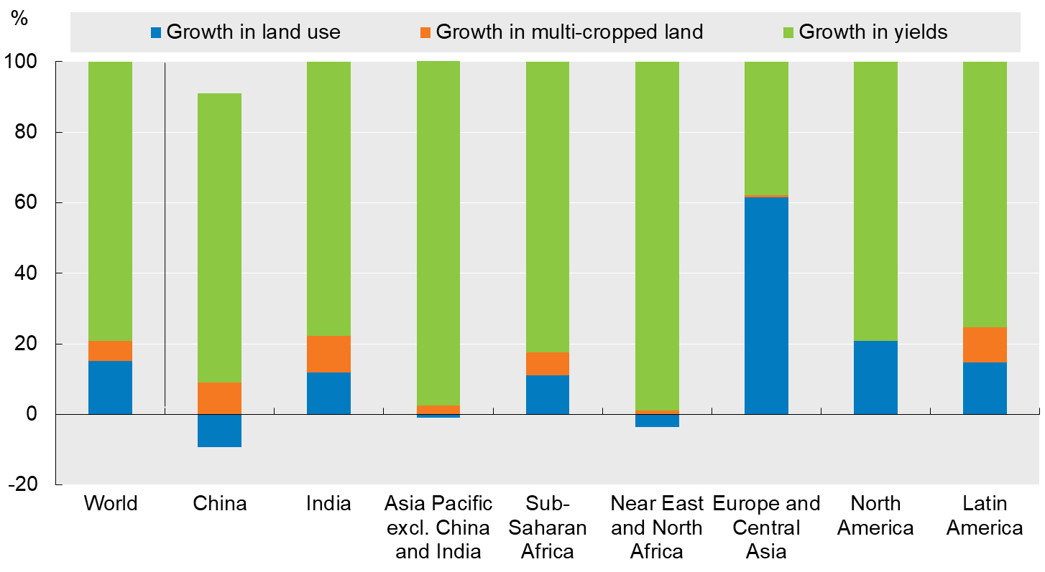
Growth in crop production driven by growth in yields
Notes:
Note: Figure shows the decomposition of total production growth (2012-21 and 2022-31) into growth in land use, land intensification through growth in multi-cropped land, and growth in yields. It covers the following crops: cotton, maize, other coarse grains, other oilseeds, pulses, rice, roots and tubers, soybean, sugarbeet, sugarcane, wheat and palm oil.

Slide 11
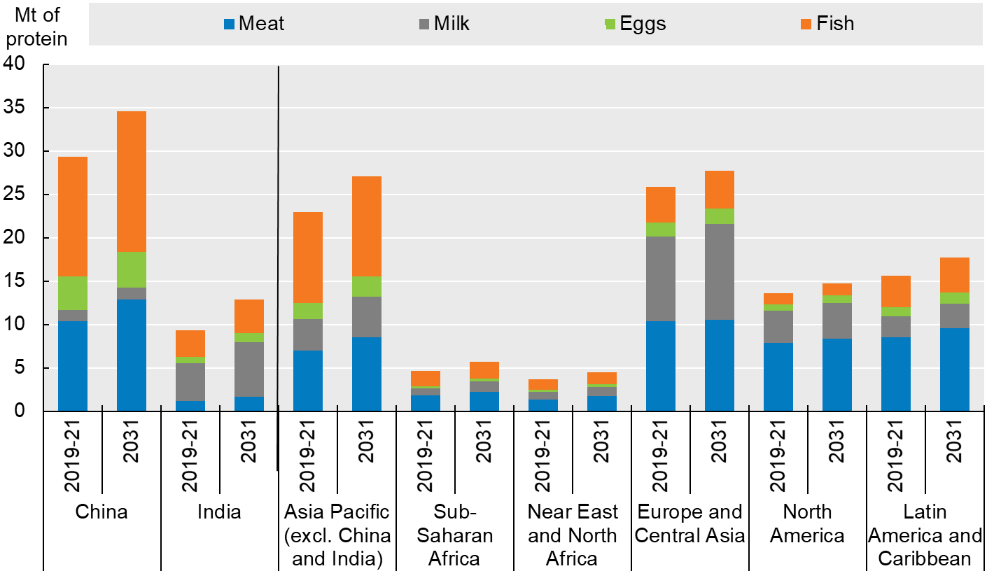
A few countries/regions dominate livestock production

Slide 12
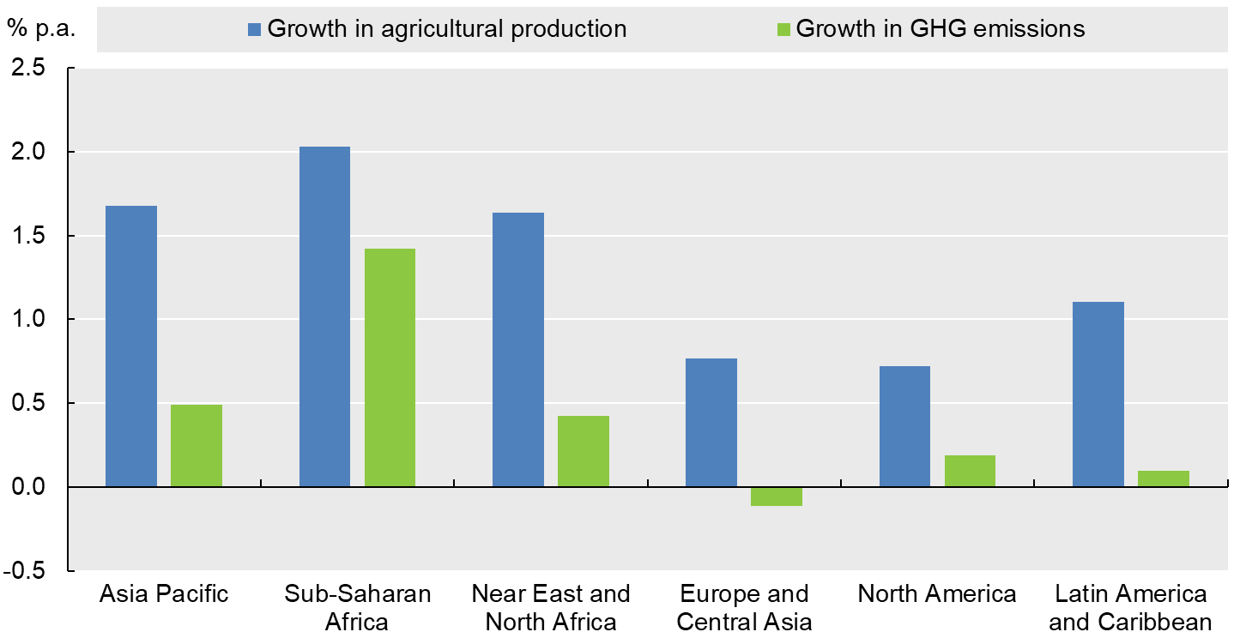
Declining carbon intensity of agricultural production
Annual change in agricultural output and direct GHG emissions, 2022-31
Notes:
Note: This figure shows projected annual growth in direct GHG emissions from agriculture together with annual growth in the estimated net value of production of crop and livestock commodities covered in the Outlook (measured in constant USD 2014-16 prices). Estimates are based on historical time series from the FAOSTAT Emissions Agriculture databases which are extended with the Outlook database.CO2 equivalents are calculated using the global warming potential of each gas as reported in the IPCC Sixth Assessment Report (AR6). Emission types that are not related to any Outlook variable (organic soil cultivation and burning Savannahs) are kept constant at their latest available value. The category ''other'' includes direct GHG emissions from burning crop residues, burning savanna, crop residues, and cultivation of organic soils. The Net Value of Production uses own estimates for internal seed and feed use.

Slide 13
Trade is essential for global food security
Calculations using average calorie content of commodities included in the Outlook. Note that exports/imports include feed, and availability includes processing of commodities which may be re-exported.
Notes:
Globally, ag trade expected to increase.
Lots of trade within regions, but inter-regional trade will also expand.
Describe slide: Net trade, Time periods, across regions of the world
Slide: net trade by region
Some regions will export growing share of ag production: Latin America and Europe
Others will increase imports due to rapid pop growth or resource constraints: SSA, South and SE Asia
SE Asia – net trade low, projected imports grow at higher rate than exports due to strong demand growth
Food Security, for resource constrained countries, where imports account for high share of calories and protein
Interdependency emphasizes importance of well-functioning, predictable trading system
Ag trade essential for food security, diverse diets and rural incomes
The regions Developed and East Asia, and South and Southeast Asia are defined as in Chapter 2.

Slide 14
Long-term evolution of commodity prices, in real terms
Notes:
Historical data for soybeans, maize and beef from World Bank, "World Commodity Price Data" (1960-1989). Historical data for pork from USDA QuickStats (1960-1989).

Slide 15
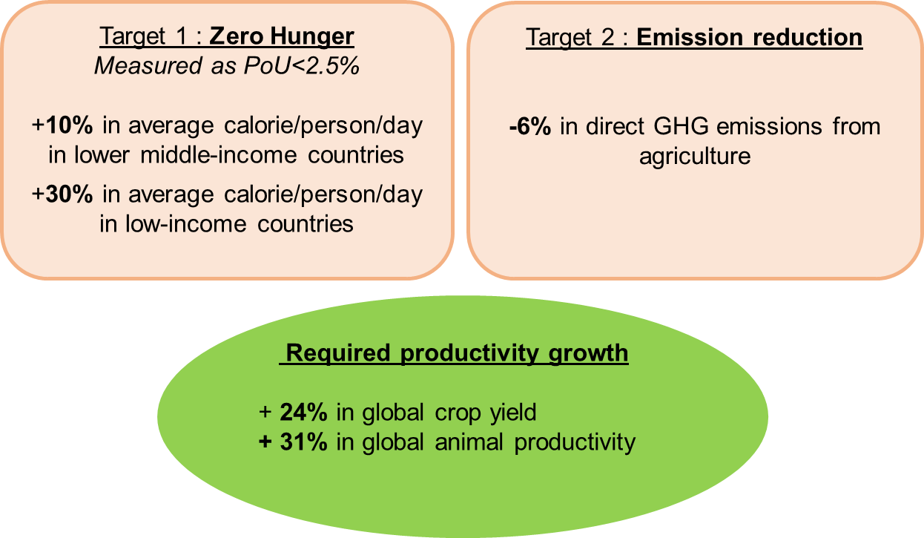
Acceleration in productivity growth needed to achieve Zero Hunger and GHG reductions by 2030

Slide 16
Innovation, biosecurity and infrastructure can boost sustainable productivity growth
General Services Support Estimate, 2019-21 (% of agricultural value of production)
Notes:
These USD 817 bn per year represent a 13% increase over the level reported for 2018-20 – much related to temporary factors (e.g. fallouts of ASF, COVID-19)
Total budgetary support to agriculture 500 billion
Expenditures on innovation systems and on other key services vary significantly across countries. Overall, however, their share in public support to the sector has decreased, from 16% two decades ago to 13% in 2019-21, even if investments in innovation, biosecurity and infrastructure can foster sustainable productivity growth – a key driver for combatting climate change and addressing other food systems challenges. Growth in innovation investments has slowed down significantly, even though investments in green innovations can reduce emissions from ag and land use by more than 40%. Reversing that trend is critical.
Indeed, a signficant part of agricultural support is not helping cc mitigation. A significant part of support – USD 76 bn p.a., is transferred to producers of beef and veal, lamb, and rice, all with high emission intensities.
Another form of support with significant potential to increase emissions is provided for the use of specific production inputs, such as fertilsers, fuel, or irrigation. While these are often not commodity specific (and hence don‘t show up in this graph), they increase the use of those inputs and the emissions related to them, in addition to other environmental pressures they may increase.

Slide 17
Key messages
Substantial acceleration in productivity growth required
  Boost agricultural investment and innovation
  Enable knowledge, technology, and skills transfers
  Increase efforts to develop coherent policy packages
A well-functioning, predictable trading system is increasingly important
  Open markets, including through trade facilitation and avoiding export restrictions
  Investing in transparency to build trust
  Regulatory harmonization to reduce unnecessary friction
Cooperation, consultation, coordination to achieve robust institutional change

